Slide 1
The American Civil War
This war was commonly known as the War Between the States.

Slide 2
- The civil war started in the year 1861 and ended in 1865. - The war began as the result of a dispute between certain southern states and certain northern slates regarding slavery and the taxation of cotton exports. - Instead of choosing peace the states chose side.
- The southern states became "The Confederacy,” an the northern states were known as "The Union."

Slide 3
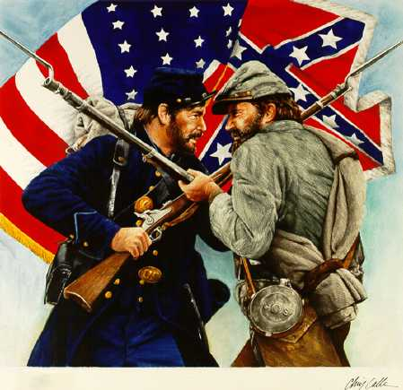
The war produced more than 970,000 casualties (3 percent of population), including approximately 560,000 deaths.
More than 600,000 men gave their lives for their country in this war.

Slide 4
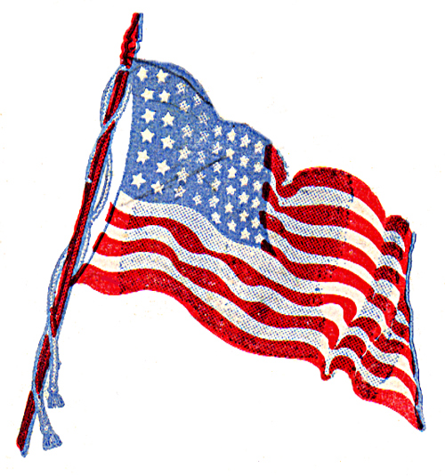
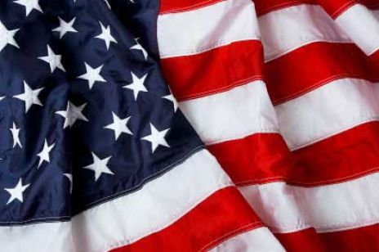
The American Civil War was one of the earliest true industrial wars. Railroads, the telegraph, steamships, and mass-produced weapons were employed extensively.
Ten percent of all Northern males 20–45 years of age died, as did 30 percent of all Southern white males aged 18–40.
Victory for the North meant the end of the Confederacy and of slavery in the United States.

Slide 5
The American Civil War
By Gregory Tennant

